Slide 1

The Project
Goal:
“Smart” Micro Grid
Designed by:
Caleb Hubbell
Rudy Ku-Cejin
Tyler La-Brae

Slide 2
How it Works
Unbalanced = problem
Access to capacitor banks
Switches
Balanced 3 phase!

Slide 3
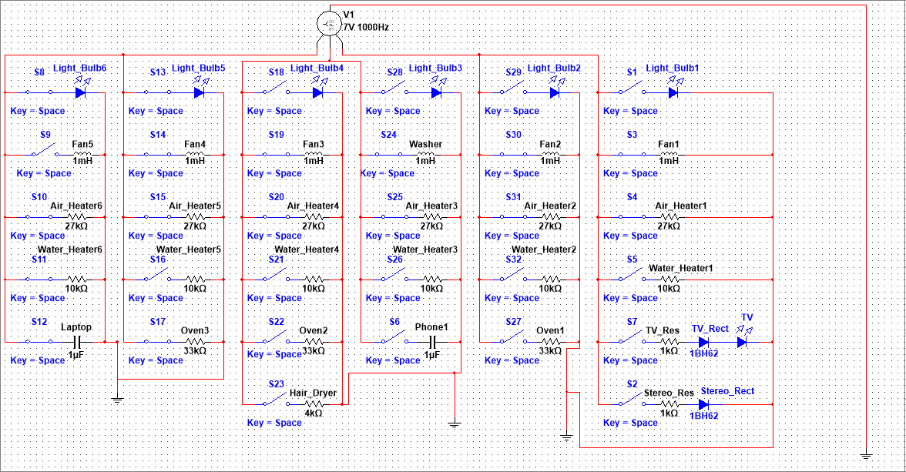
General Arrangement

Slide 4
Power Issues
Caps lead
Inductors follow
Need fix
Notes:
RUdy speaks here

Slide 5
Why Should You Choose us?
I mean, look at us...

Slide 6
Cost
1 bajillion
USD

Slide 7
Problems We Encountered
Specs are appreciated.
Phases everywhere.

Slide 8
How Will This Help?
Because it uses less power...duh

Slide 9
Conclusion
Give us a good grade. We worked hard.

Slide 10
Future Improvement Ideas
Use solar panels. They make DC power. It's better.

